Slide 1


Insurance Charges Prediction Using Machine Learning
Predict insurance costs using personalized data and algorithms.
Empowering users with transparent and data-driven insights.
Making informed decisions about insurance coverage.

Slide 2
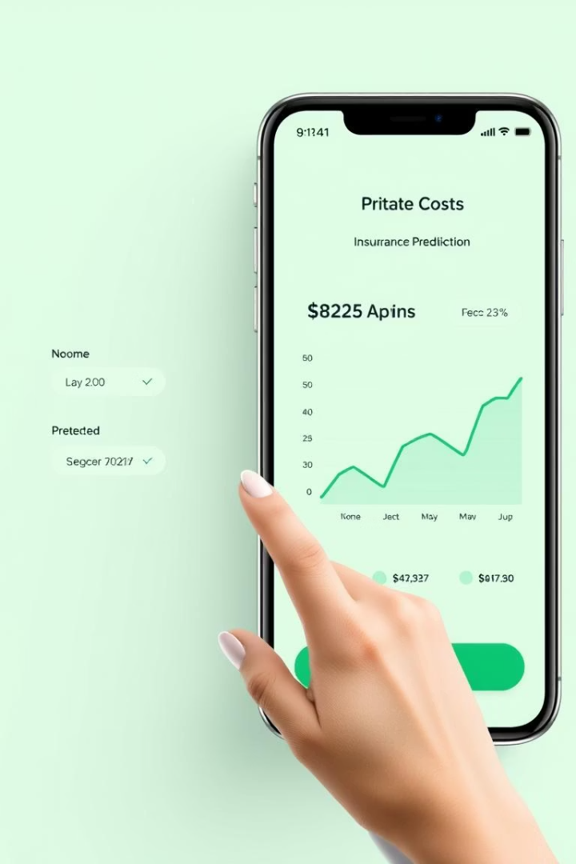




App Purpose and Overview
Estimate Charges
Leverage ML
Simplify Selection
Personalized insurance cost predictions.
Machine learning for accurate forecasts.
Streamlined insurance choice process.
Interactive Interface
Easy data input and results.

Slide 3

User Input Parameters
Age
Children
Continuous variable, risk assessment.
Integer variable, family plans.
Smoking
Sex
Binary, significant health risk.
Male/female, influences premiums.
Region
BMI
US geographic area, healthcare costs.
Body mass index, health risk.

Slide 4
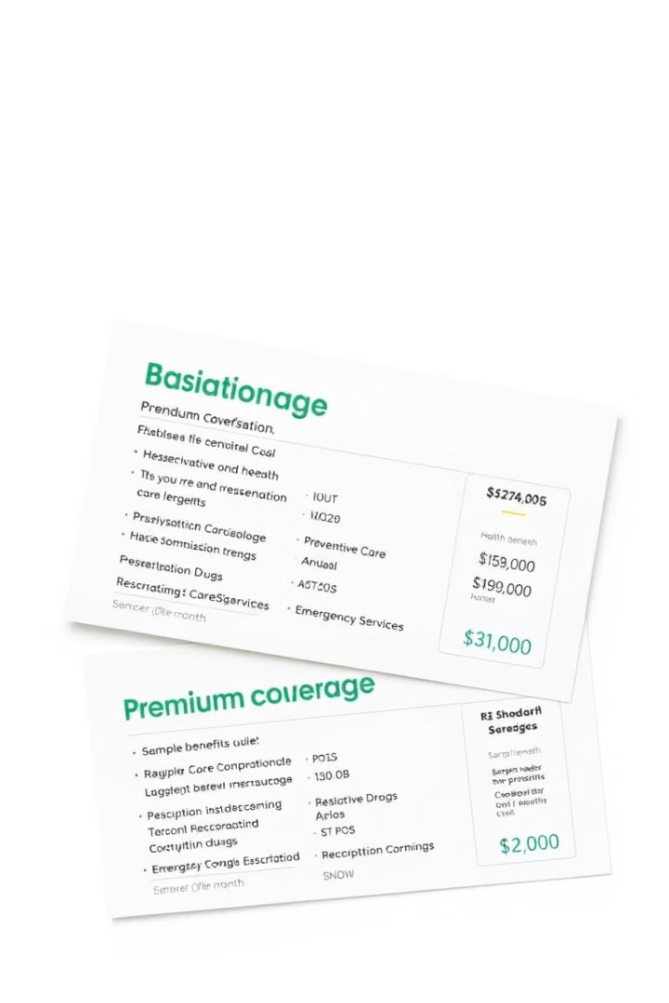
Insurance Plans Overview
Basic
Limited
$5,000
$150
Standard
Moderate
$2,500
$300
Premium
Comprehensive
$1,000
$500
Policy duration (months): Variable impacting overall cost.

Slide 5
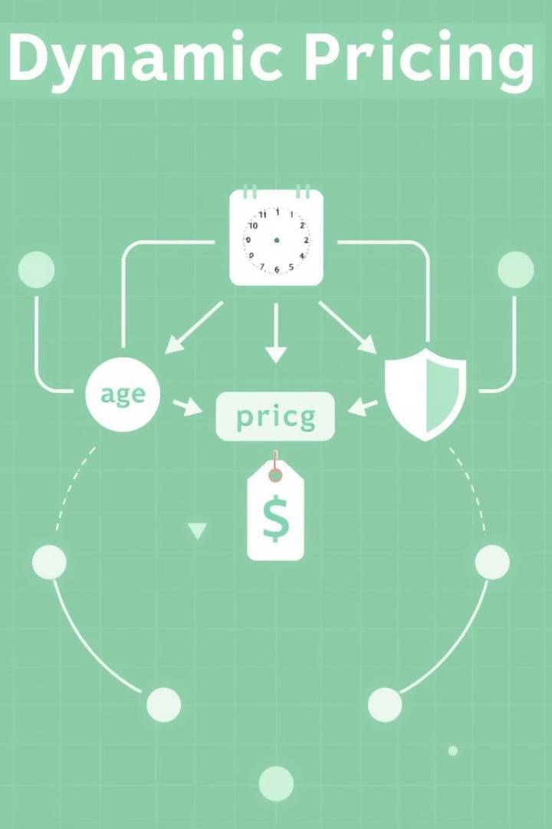




Dynamic Pricing Logic
Our pricing model adapts to individual circumstances, ensuring fair and accurate premiums.
Base Premium
Starting point for all calculations.
Age Factor
Linear increase with age.
BMI Factor
Higher for unhealthy BMI ranges.
Risk Adjustments
Smoking, dependents, pre-existing conditions.

Slide 6
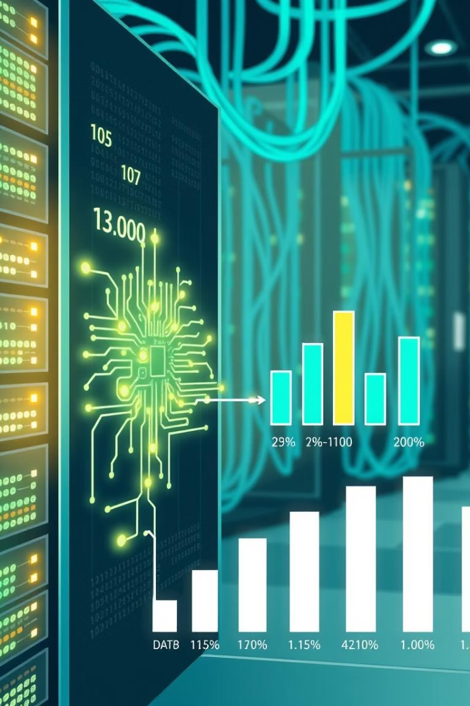




Machine Learning Prediction Process
Data Collection
Historical claims, user data.
Model Training
Algorithms predict charges.
Feature Importance
Identify key cost factors.
Model Validation
Accuracy and reliability.
Algorithms used: Linear Regression, Random Forest. R-squared value = 0.85

Slide 7
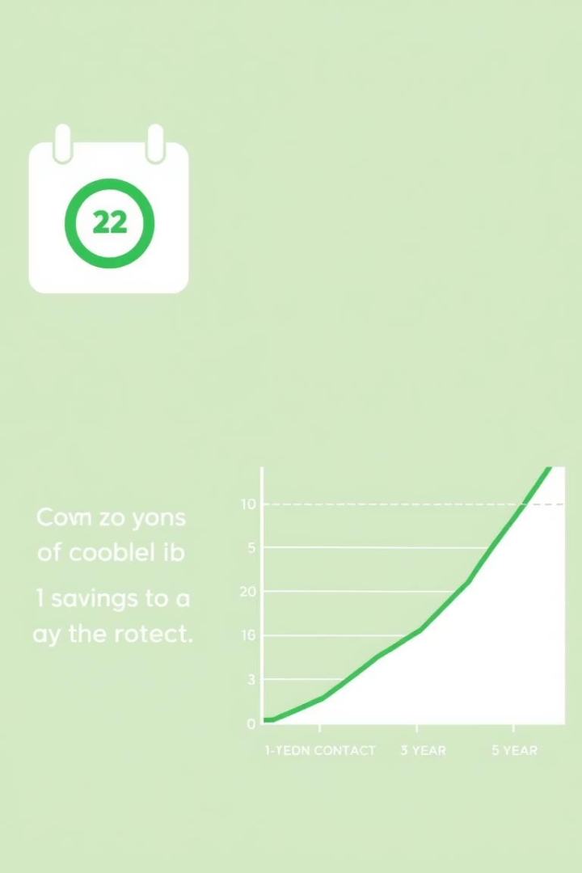
Policy Duration Impact
12
$3,600
0%
36
$10,200
6%
60
$16,800
7%
Longer policy durations often result in lower monthly premiums due to reduced administrative overhead and increased customer retention.

Slide 8
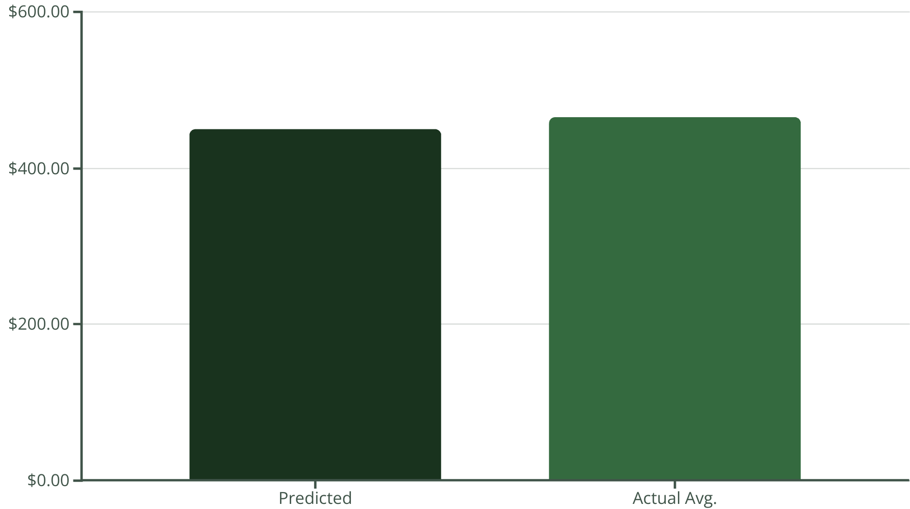
Prediction Results and Visualization
Sample prediction: 30-year-old male, BMI 28, smoker, Standard plan: $450/month.
User feedback: 90% satisfaction rate with prediction accuracy.

Slide 9
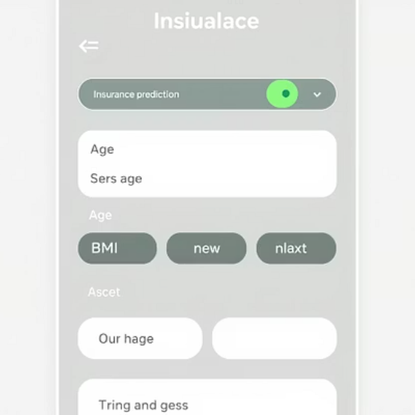
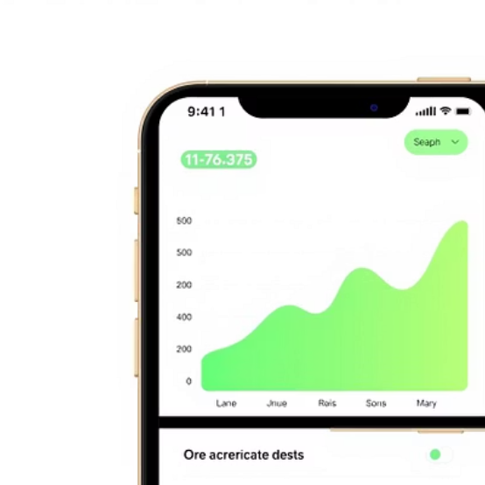
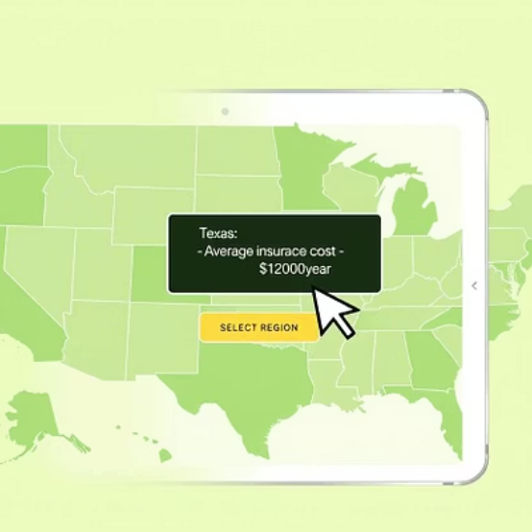
Visual Examples
Explore the app interface and visualize your data.

Slide 10





Conclusion and Future Improvements
Accurate Predictions
Real-time Quotes
Personalized insurance charge forecasts.
Integration with live insurance data.
Expanded Data
Advanced Models
More diverse information sources.
Sophisticated machine learning.
Goal: Empower users to make well-informed decisions about insurance.

